Slide 1
Quality Assurance & Implementation
16
Systems Analysis and Design,
Kendall & Kendall

Slide 2
Software Quality Assurance
SQA:
  controls the processes used in producing software
  assures that standards, rules and procedures are established and followed throughout the software development life cycle.
Kendall & Kendall
16-<number>

Slide 3
Approaches to Quality Assurance
Securing total quality assurance through designing systems and software with a top-down and modular approach
Documenting software with appropriate tools
Testing, maintaining, and auditing software
Kendall & Kendall
16-<number>
Notes:
Two thoughts guide quality assurance:
The user of the information system is the single most important factor in establishing and evaluating its quality.
It is far less costly to correct problems in their early stages than it is to wait until a problem is articulated through user complaints or crises.

Slide 4
Major Topics
Six Sigma
Quality assurance
Walkthroughs
Structure charts
Modules
Data and control passing
Documentation
Testing
Kendall & Kendall
16-<number>

Slide 5
Six Sigma
Total quality management (TQM) is essential throughout all the systems development steps.
The concept of quality has broadened over the years to reflect an organizational, rather than an exclusively production, approach.
The goal of six sigma is to eliminate all defects.
Six sigma is a methodology, a philosophy and a culture.
Kendall & Kendall
16-<number>

Slide 6
Six Sigma
A culture built on quality
Uses a top-down approach
Project leader is called a Black Belt
Project members are called Green Belts
Master Black Belts have worked on many projects and are available as a resource to project teams
Kendall & Kendall
16-<number>

Slide 7
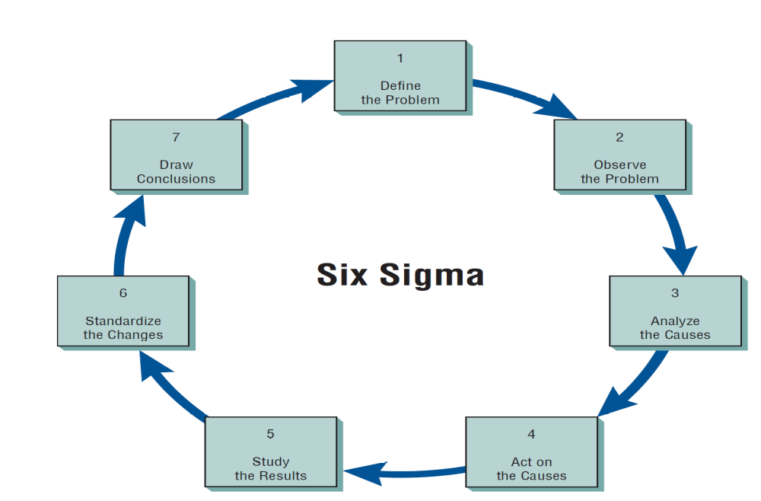
Six Sigma
Kendall & Kendall
16-<number>

Slide 8
Structured Walkthroughs
One of the strongest quality management actions is to do structured walkthroughs routinely
Use peer reviewers to monitor the system's programming and overall development
Point out problems
Allow the programmer or analyst to make suitable changes
Kendall & Kendall
16-<number>
Notes:
The point of the structured walkthrough is to evaluate the product systematically on an ongoing basis.

Slide 9
Involved in Structured Walkthroughs
The person responsible for the part of the system being reviewed
A walkthrough coordinator
A programmer or analyst peer
A peer who takes notes about suggestions
Kendall & Kendall
16-<number>
Notes:
Structured walkthroughs involve at least four people.
Coordinator – ensures that the others adhere to any roles assigned to them and to ensure that any activities scheduled are accomplished.
Programmer or analyst – there to listen.
Programmer or analyst peer – present to point out errors or potential problems.
Notetaker – records what is said so that the others present can interact without encumbrance.

Slide 10
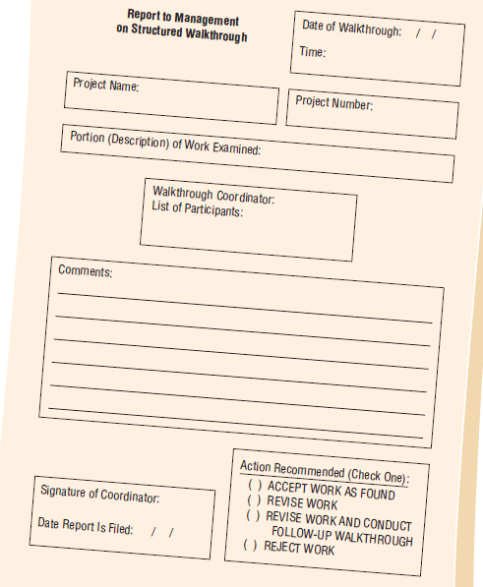
Kendall & Kendall
16-<number>

Slide 11
Modular Development
Breaking the programming into logical, manageable portions or modules
Works well with top-down design
Each individual module should be functionally cohesive, accomplishing only one function
Kendall & Kendall
16-<number>
Notes:
This kind of programming works well with top-down design because it emphasizes the interfaces between modules and does not neglect them until later in systems development.

Slide 12
Advantages of Modular Programming
Modules are easier to write and debug
Modules are easier to maintain
Modules are easier to grasp because they are self-contained subsystems
Kendall & Kendall
16-<number>
Notes:
Modules are easier to write and debug –
Tracing an error in a module is less complicated.
A problem in one module should not cause problems in others.
Modules are easier to maintain – modifications will usually be limited to a few modules and will not be spread over an entire program.
Modules are easier to grasp because they are self-contained subsystems – a reader can pick up a code listing and understand its function.

Slide 13
Guidelines for Modular Programming
Keep each module to a manageable size
Pay particular attention to the critical interfaces
Minimize the number of modules the user must modify when making changes
Maintain the hierarchical relationships set up in the top-down phases
Kendall & Kendall
16-<number>

Slide 14
Using Structure Charts to Design Systems
The recommended tool for designing a modular, top-down system is a structure chart
A structure chart is simply a diagram consisting of rectangular boxes, representing the modules, and connecting lines
Kendall & Kendall
16-<number>

Slide 15
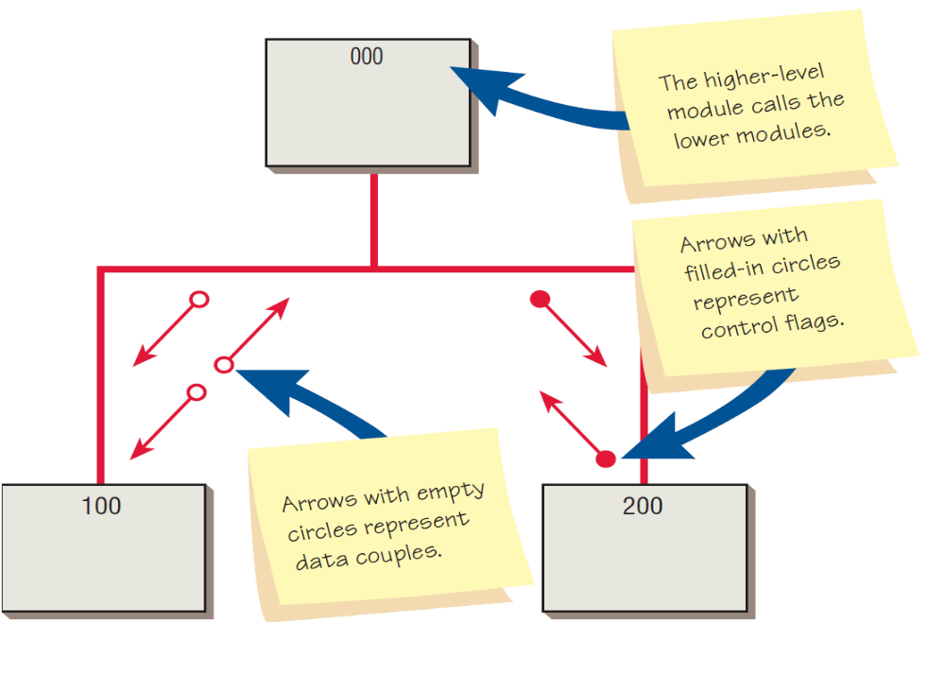
Kendall & Kendall
16-<number>
Notes:
The numbering allow programmers to insert modules between modules – a module inserted between modules 110 and 120 might be 115.
The arrows with the empty circles represent data couples.
The arrows with the filled-in circles represent control flags or switches.
The arrows indicate that something is passed either down to the lower module or up to the upper one.

Slide 16
Data Couples and Control Flags
  The fewer control flags and data couples in the system, the easier it is to change the system
  Control flags govern which portion of a module is to be executed and associated with IF…THEN…ELSE…and other similar statements
  Data coupling is when only data required is passed through the data couple
Kendall & Kendall
16-<number>

Slide 17
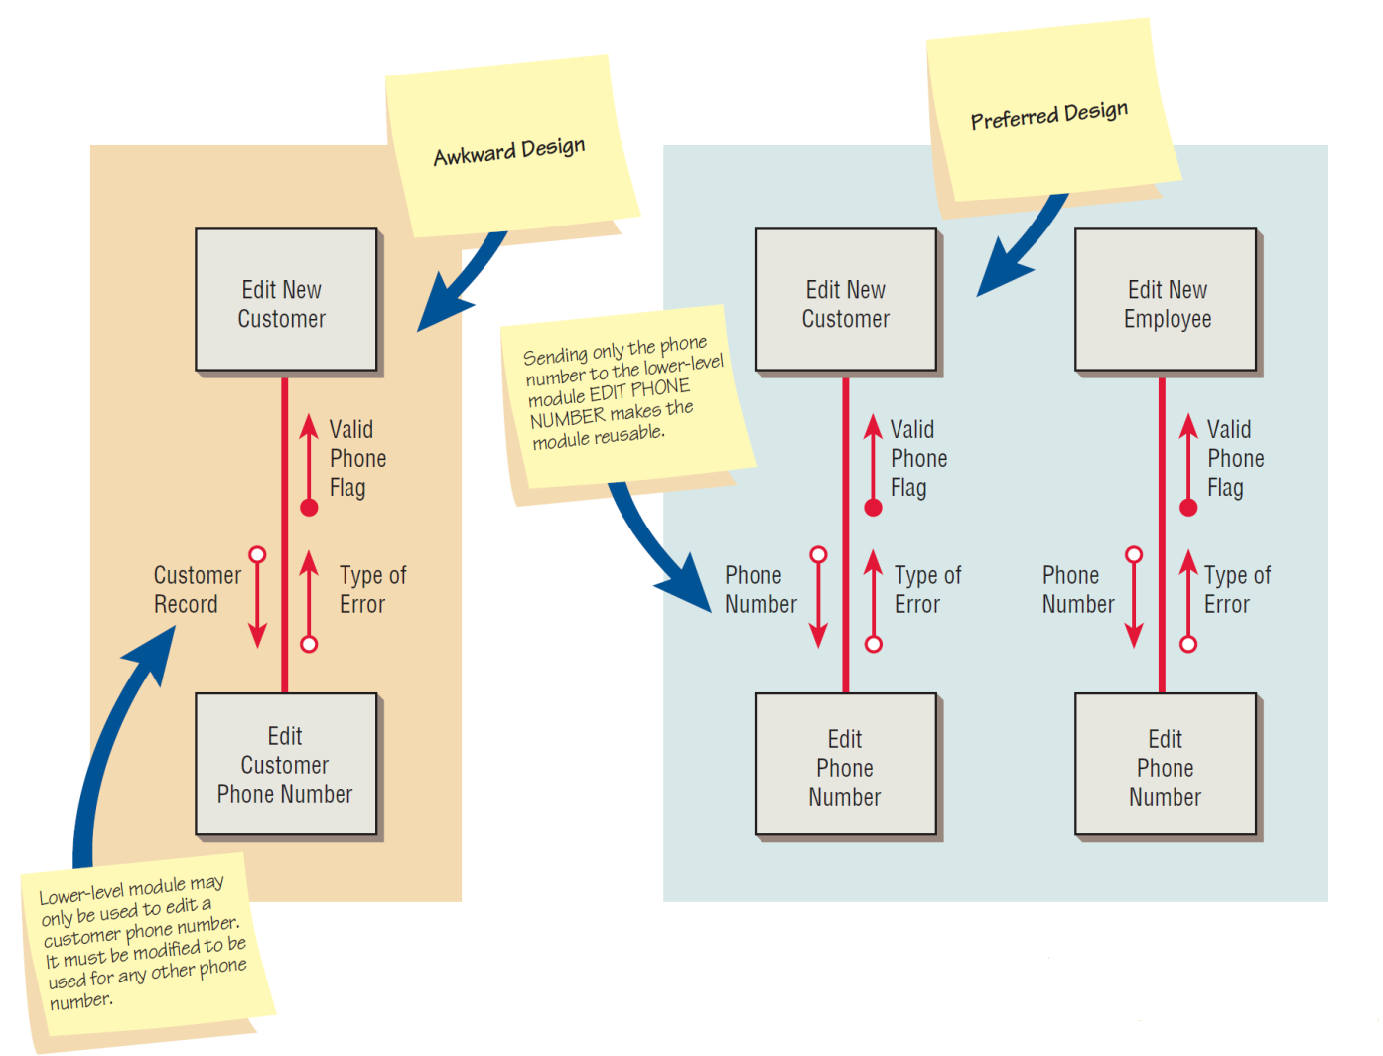
Figure 16.8 Creating reusable modules
Kendall & Kendall
16-<number>

Slide 18
Why Coupling is Important
Coupling or dependency is the degree a program module relies on another module
When modules are loosely coupled (low dependency), changes in one module will not require a change in another module
Tightly coupled modules are difficult to: test, understand in isolation, re-use, and maintain
Kendall & Kendall
16-<number>

Slide 19
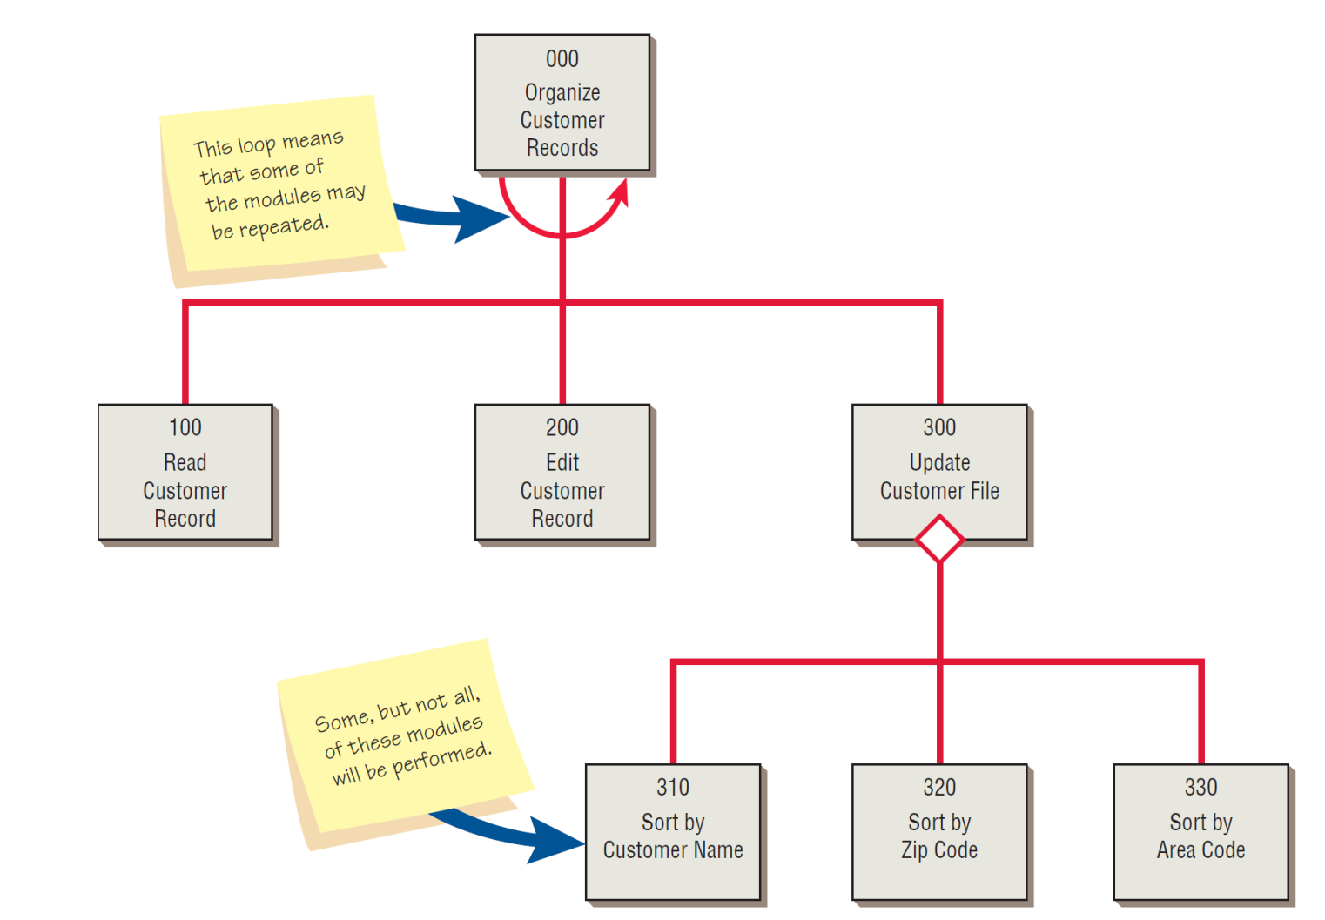
Kendall & Kendall
16-<number>
Notes:
The loop indicates that some procedures are to be repeated until finished.
The diamond indicates that some, but not necessarily all of the modules will be performed.

Slide 20
Drawing a Structure Chart
A data flow diagram may be used to create a structure chart
  Indicates the sequence of the modules
  Indicates modules subordinate to a higher module
Kendall & Kendall
16-<number>
Notes:
Indicates the sequence of the modules – if one process provides input to another process, the corresponding modules must be performed in the same sequence.
Indicates modules subordinate to a higher module – if a process explodes to a child data flow diagram, the module corresponding to the parent process will have subordinate modules that correspond to the processes found on the child diagram.

Slide 21
Types of Modules
Control modules
Transformational modules
Functional modules
Kendall & Kendall
16-<number>
Notes:
Control modules - determining the overall program logic.
Transformational modules - changing input into output.
Functional modules - performing detailed work.

Slide 22
Control Modules
Found near the top of the structure chart and contain the logic for performing the lower-level modules
May or may not be represented on the data flow diagram
Usually contains IF, Perform, and DO statements
Should not be very large in size
Kendall & Kendall
16-<number>
Notes:
Should not be very large in size – size should be kept to a minimum. If a control module has more than nine subordinate modules, new control modules should be created that are subordinate to the original control module.
The logic of a control module can be determined from a decision table or a decision tree.

Slide 23
Transformational Modules
Created from a data flow diagram
Usually perform only one task
Have mixed statements, IF and PERFORM or DO statements and many detailed statements such as MOVE and ADD
Kendall & Kendall
16-<number>
Notes:
Created form a data flow diagram – some found on the data flow diagram, but others may have to be added.
Usually perform only one task – formatting, reading, calculating, or writing.
These modules are lower in the structure than control modules

Slide 24
Functional Modules
Perform only one task
The easiest to code, debug, and maintain
Kendall & Kendall
16-<number>

Slide 25
Kendall & Kendall
16-<number>
Notes:
Modules 000 and 100 are control modules, representing the entire program.
Module 190 is a transformational module that formats the RESERVATION RECORD and performs module 200 to write the RESERVATION RECORD.
Modules 130, 140, 150, 170, 180, 200 are functional modules, performing only one task.

Slide 26
Software Engineering and Documentation
The total quality assurance effort requires that programs be documented properly
Documentation
  Allows you to “see” the system without having to interact with it
  Provides an overview of the system itself
  Shortens time to perform maintenance
Kendall & Kendall
16-<number>
Notes:
The structure chart cannot stand alone as the sole design and documentation technique.
it doesn’t show the order in which the modules should be executed.
it doesn’t show enough detail.
Allows you to “see” the system without having to interact with it – documentation should be prototyped before it is considered complete.
Provides an overview of the system itself – procedural documentation details what must be done to run software on the system; program documentation details the program code that is used.
Shortens time to perform maintenance – do to turn over of personnel, people who conceived of and installed the original system will not be the same ones who maintained it.

Slide 27
System Documentation
Pseudocode
Procedure manuals
The FOLKLORE method
Kendall & Kendall
16-<number>
Notes:
There is no single standard design and documentation technique in use today. Each technique has its own advantages and disadvantages, because each one has unique properties.

Slide 28
Pseudocode
Similar to structured English
It is not a particular type of programming code, but it can be used as an intermediate step for developing program code
Kendall & Kendall
16-<number>

Slide 29
pseudocode
Kendall & Kendall
16-<number>

Slide 30
Procedure Manuals
The English-language component of documentation
Key sections
  An index
  Introduction
  How to use the software & complete the tasks
  What to do if things go wrong
  A technical reference section
  Information on how to contact the manufacturer
Kendall & Kendall
16-<number>
Notes:
Procedure Manuals – may also contain program codes, flowcharts, and so on.
intended to communicate to those who use them.

Slide 31
Procedure Manuals (Continued)
Procedure manual complaints
  They are poorly organized
  It is hard to find needed information
  The specific case in question does not appear in the manual; how-to-use software book, instead of how-to-complete-a-task using the software
  The manual is not written in plain English
Kendall & Kendall
16-<number>

Slide 32
Web Documentation
FAQ (Frequently Asked Questions)
Help desks
Technical support
Fax-back services
Downloading patches and updates
Kendall & Kendall
16-<number>

Slide 33
The FOLKLORE Method
Collects information in the categories
  Customs
  Tales
  Sayings
  Art forms
Kendall & Kendall
16-<number>
Notes:
Created to supplement other document techniques.
FORKLORE gathers information that is often shared among users but is seldom written down.
Customs – tries to capture in writing what users are currently doing to get all programs to run without problems.
Tales – stories that users tell regarding how the system worked.
Sayings – brief statements representing generalizations or advice.
Art forms – flowcharts, diagrams, and tables that users draw sometimes may be more useful than flowcharts drawn by the original system author.

Slide 34
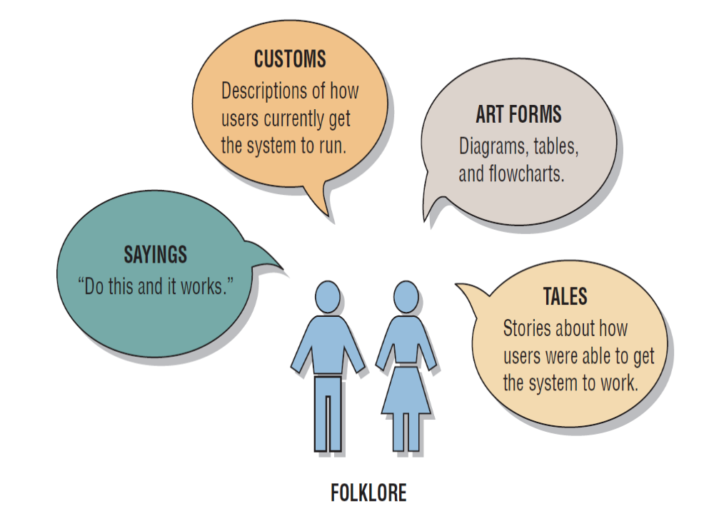
Kendall & Kendall
16-<number>
Notes:
The danger of relying on FOLKLORE is that the information gathered from users may be correct, partially correct, or incorrect.

Slide 35
Choosing a Design and Documentation Technique
Is it compatible with existing documentation
Is it understood by others in the organization
Does it allow you to return to working on the system after you have been away from it for a period of time
Kendall & Kendall
16-<number>

Slide 36
Choosing a Design and Documentation Technique (Continued)
Is it suitable for the size of the system you are working on
Does it allow for a structured design approach if that is considered to be more important than other factors
Does it allow for easy modification
Kendall & Kendall
16-<number>

Slide 37
Testing, Maintenance, and Auditing
The testing process
Maintenance practices
Auditing
Kendall & Kendall
16-<number>
Notes:
Once the analyst has designed and coded the system, testing, maintenance, and auditing of it are prime considerations.

Slide 38
Verification and Validation
Verification: “Did we build the software right?” (Does it match specifications?)
Validation: “Did we build the right software?” (Is this what the customer needs?)
V&V are used to check that the product meets its intended purpose, and are critical components of a quality management system
Kendall & Kendall
16-<number>

Slide 39
Approaches to Verification and Validation
Two complementary approaches:
  Software inspections or peer reviews
  Software testing
    Validation testing: show that the software meets the customer’s requirements
    Defect testing: reveal inconsistencies between the software and its specification (bugs)
Kendall & Kendall
16-<number>

Slide 40
The Testing Process
Program testing with test data
Link (integration) testing with test data
Full system testing with test data
Full system testing with live data
Kendall & Kendall
16-<number>
Notes:
All the system’s newly written or modified application programs --- as well as new procedural manuals, new hardware, and all system interfaces --- must be tested thoroughly.

Slide 41
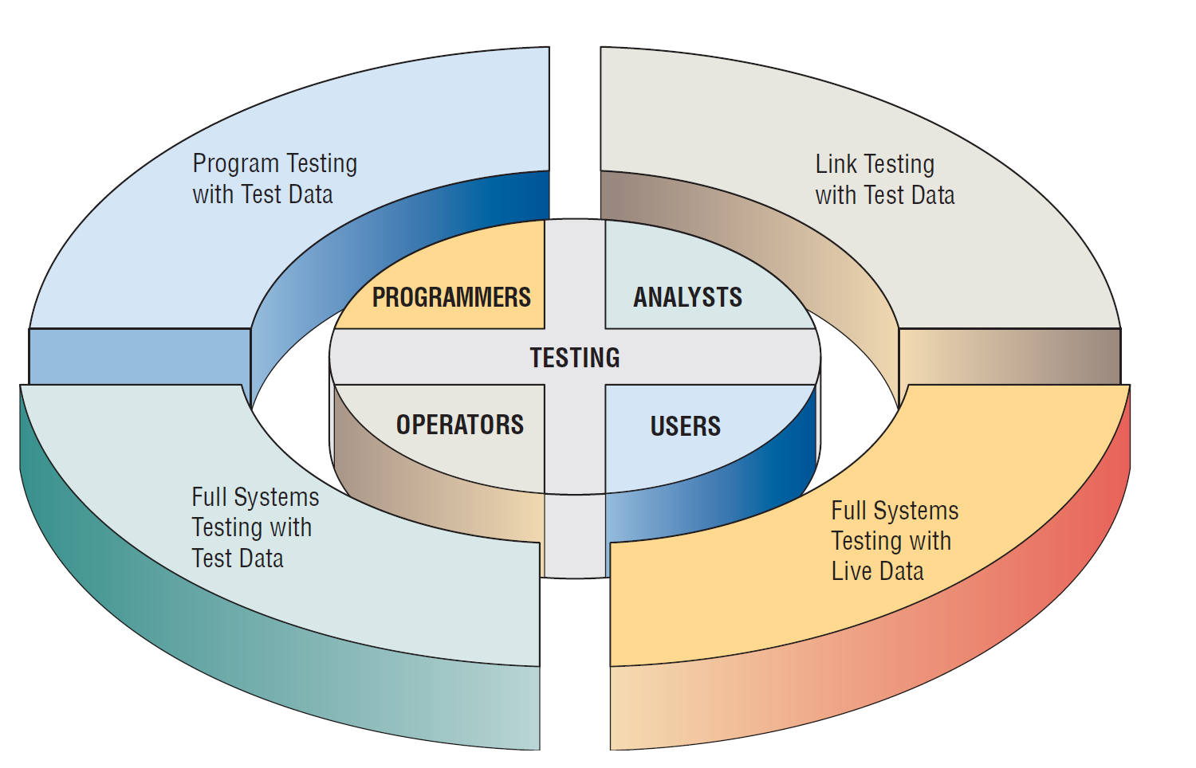
Figure 16.19 Programmers, analysts, operators, and users all play different roles in testing software and systems
Kendall & Kendall
16-<number>
Notes:
Programmers, analysts, operators, and users all play different roles in the various aspects of testing.

Slide 42
Program Testing with Test Data
Desk check programs
Test with both valid and invalid data
Check output for errors and make any needed corrections
Kendall & Kendall
16-<number>
Notes:
Desk check programs – the programmer follows each step in the program on paper to check whether the routine works as it is written.
Test with both valid and invalid data – these data are run to see if base routines work and also to catch errors.
Check output for errors and make any needed corrections – the analyst might point out to the programmer omissions of data types to be added in later tests.

Slide 43
Link Testing with Test Data
Also referred to as string testing
Checks to see if programs that are interdependent actually work together as planned
Test for normal transactions
Test with invalid data
Kendall & Kendall
16-<number>
Notes:
Test for normal transactions – those that make up the bulk of the load.
Test with invalid data – if the system works with normal transactions, variations are added, including invalid data used to ensure that the system can properly detect errors.

Slide 44
Full System Testing with
Test Data
Adequate documentation in procedure manuals
Are procedure manuals clear enough
Do work flows actually “flow”
Is output correct and do users understand this output
Kendall & Kendall
16-<number>
Notes:
When link tests are concluded, the system as a complete entity must be tested.
Operators and end users become actively involved in testing.
Adequate documentation in procedure manuals – to afford correct and efficient operation.
Are procedure manuals clear enough – do they communicate how data should be prepared for input.
Do work flows actually “flow” – those work flows necessitated by the new or modified system.
Is output correct and do users understand this output – do users understand that this is how it will look in its final form.

Slide 45
Full System Testing with Live Data
Comparison of the new system’s output with what you know to be correctly processed output
Only small amounts of live data are used
Kendall & Kendall
16-<number>
Notes:
Live data – data that have been successfully processed through the existing system.

Slide 46
Maintenance Practices
Reduce maintenance costs
Improve the existing software
Update software in response to the changing organization
Ensure channels for feedback
Classification scheme
Kendall & Kendall
16-<number>
Notes:
The better the system design, the easier it will be to maintain and the less money the business will have to spend on maintenance.
Reduce maintenance costs – software maintenance can devour upwards of 50 percent of the total data processing budget for a business. Approximately 70 percent of software errors have been attributable to inappropriate software design.
Improve the existing software – rather than to respond to a crisis or failure.
Update software in response to the changing organization – emergency and adaptive maintenance comprises less than half of all system maintenance.
Ensure channels for feedback – users must be able to communicate problems and suggestions easily to those who will be maintaining the system.
Classification scheme – designates the perceived importance of the maintenance being suggested.

Slide 47
Auditing
Having an expert who is not involved in setting up or using the system examine information in order to ascertain its reliability
There are internal and external auditors
Internal auditors study the controls used in the information system to make sure that they are adequate
External auditors are used when the information system processes data that influences a company’s financial statements
Kendall & Kendall
16-<number>
Notes:
Internal auditors work for the same organization that owns the information system.
External auditors are hired from the outside.

